Slide 1
Promerus Contractor Training Presentation
Last Updated 11/1/2021

Slide 2
Outline of Contractor Training
Work Categories and Responsibilities
General Site and Security Information
Prohibited Substances and Workplace Violence
Items Brought on Site
Onsite Injury Reporting
Emergencies and Evacuations
Proper Attire and PPE
Contractor Work Permit
Cardinal Rules and Permits
Special Permits and Permissions
Use of Vertical Mast Lift
Roof Work

Slide 3
Contractor Work Categories
 |  | Contractor Work Permit | Contractor Safety Presentation | Contractor Safety Test | Area Specific Training | Chemical Specific Training
Hazardous Area | Unescorted | ✓ | ✓ | ✓ | ✓ | ✓
 | Escorted
Non-Hazardous Area | Unescorted | ✓ | ✓ | ✓
 | Escorted
Outside Area | Exempt

Slide 4
Contractor Responsibilities
Comply with all site policies, all applicable laws and all applicable OSHA standards
Must monitor its employees for compliance to these policies and laws while on site
Must provide to Promerus Contact SDS documents for all hazardous chemicals to be brought on site
Must notify Promerus Contact of any work-related illness, accident, spill, or property damage
Must keep work areas clean and store tools/work equipment properly at the end of each work day
Maintain proper access to all aisle ways, emergency exits and safety equipment within work areas

Slide 5
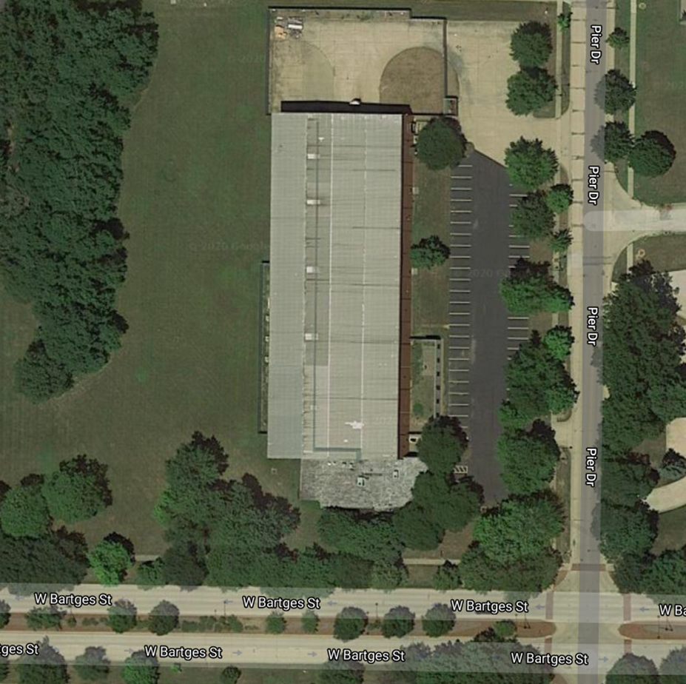


General Site Layout
Main Entrance
Parking Entrance
N

Slide 6
Site Entry
Enter at the main/front entrance vestibule or as directed by your Promerus Contact
  Sign in and out on the Contractors Log posted on the door of the Electrical Room
Promerus Contact
  If Promerus Contact verifies that training occurred within last 12 months, then directs contractor to work location.
  If training has not occurred within last 12 months, Promerus Contact will take contractor to training area to complete required training.
  If contractor will be escorted at all times while on-site then no contractor formal training required

Slide 7
Smoking Prohibited
Smoking/Vaping is not permitted anywhere on site including parking lot
Smoking/Vaping may be done on the sidewalks along Pier Drive or West Bartges Street
No use of matches, lighters or open flames in any site location without a Hot Work permit

Slide 8
Illegal Substances Prohibited
No illegal substances or alcohol can be brought on site
Contractors cannot be under the influence of any illegal substance or alcohol while on site
Does not pertain to legal prescription medications

Slide 9
Site Security Rules
Contractors are restricted to areas where they are authorized to perform work
Contractors have access to restrooms and break areas as specified by the Promerus Contact
No horseplay, fighting or gambling permitted on site

Slide 10
Workplace Violence Policy
Promerus will not tolerate violence in any form at the workplace
This policy applies to all employees, clients, customers, vendors and persons doing business with Promerus
Examples of conduct that violates this policy:
  Physical assaults or threats
  Verbal conduct that has the purpose or effect of threatening another person
  Possession of firearms or any other lethal weapon while on company property (with the exception that they can be stored in your personal vehicle in accordance with concealed weapon carry laws)
  Where such actions involve non-employees, Promerus will take appropriate actions based on the circumstances

Slide 11
Items Brought on Site
Tools/Equipment
Ladders
Electrical Devices
Cameras
Chemicals
Gas Cylinders

Slide 12
Tools/Equipment
All equipment must be in good working condition and meet any applicable standards (i.e. OSHA)
Electrical tools may require a Hot Work Permit prior to use in certain areas (check with Promerus Contact)

Slide 13
Ladders
  All ladders must be in good working condition
  Aluminum ladders are not permitted in areas with potential electrical contact (i.e. work by electricians)
  Wooden ladders are not permitted
  Extension ladders must be properly tied-off

Slide 14
Electrical Device Use In Electrically Classified Areas
Electrical Devices
  Devices such as cellular phones, laptops and tablet computers, etc. are not permitted in electrically classified areas, unless specifically labeled intrinsically safe

Slide 15
Chemicals
Provide Promerus Contact in advance with SDS documents for all hazardous chemicals to be brought on site. Promerus authorization must be obtained prior to bringing any hazardous material on site.
  Promerus maintains SDS documents for all Promerus-used chemicals on site
  Your Promerus Contact can provide you with SDS documents for any Promerus-used chemicals present in the work area
Clean up all chemicals (including spills) immediately and properly dispose of all hazardous waste generated from work performed while on site.

Slide 16
Compressed Gas Cylinders
Keep compressed gas cylinders in vertical position and properly secured at all times.
Close gas cylinder main supply valve and place protective cap on compressed gas cylinders when not in use.

Slide 17
Permission Before Use
Please ask your Promerus Contact for permission to use the following items before use:
  Knives
  Cameras
  Cell phone Cameras
    Use of cell phones do not require permission, however, use of cell phone cameras require permission

Slide 18
On Site Injury Reporting
Report immediately to Promerus Contact any injury that occurs while working on site
Follow up and report the on site injury to your company supervisor as soon as possible (i.e. same day of injury)

Slide 19
Emergency and Evacuation Situations
Medical only emergency (i.e. heart attack)
  Call 911
  Notify the Promerus Contact
All other emergencies (spills, fires, utility breaks, etc.)
  Use pull station in building and evacuate
  Report to designated area to meet emergency response team
    Sidewalk between the parking lot and Pier St.

Slide 20
Work Clothing and PPE
Wear appropriate attire when onsite
  No tank tops, open shirts, open-toed shoes
No contact lenses permitted in hazardous work areas (such as labs, chemical storage, mechanical room, cleanroom)
Minimum required PPE in hazardous work areas (labs, chemical storage, mechanical room, cleanroom) is:
  Long sleeves
  Pants (no shorts or skirts)
  Safety glasses with side shields (meet ANSI Z87)
  Steel/Composite-toe safety shoes
Wear any additional required PPE as defined on the contractor daily work permit or as instructed by the Promerus Contact

Slide 21
Contractor Daily Work Permit
Must be completed each day before work begins
Promerus Contact must review work area hazards, PPE and all special permit requirements with all contractors each day before work begins
Each contractor must sign the daily work permit
Promerus Contact must sign the daily work permit
Completed and authorized daily work permit is posted in the work area or carried with the contractor
Work cannot start until Contractor Daily Work Permit has been signed and authorized

Slide 22
Promerus Cardinal Rules
Promerus has 4 Cardinal Rules which are critical to your safety while working on site
  Hot Work
  Lockout/Tag Out
  Confined Space Entry
  Trailer Entry

Slide 23
Hot Work
Requires a separate permit that is valid for 4 hours maximum duration
Hot Work includes:
  use of equipment capable of being an ignition source in electrically classified areas, chemical storage areas and laboratories
  work with open flames or torches anywhere on site
Notify Promerus Contact of Hot Work in advance to obtain proper permitting

Slide 24
Lockout/Tag Out
Mandatory rule is group lock out
Promerus authorized employee must perform the LOTO and/or line break
Lockout permit for equipment lockout must be completed
Each worker installs their individual lock and tag on each locking device employed
Each worker tests and verifies that the equipment is de-energized and safe to work on
Each worker must keep their own lockout keys in their possession at all times

Slide 25
Confined Space
Confined Spaces
  areas with limited means for entry/exit
  are not intended for human occupancy
Entry into a confined space requires special training and a separate confined space entry permit
A contractor entering a permit required space must have their written plan approved by the Safety Manager and it must meet all requirements of the OSHA standard.

Slide 26
Trailer Entry
No contractor is permitted to enter a trailer with a forklift.

Slide 27
Special Permission
Special permission must be obtained from the Promerus Contact prior to:
  making facility service tie-ins (utilities, electrical, HVAC)
  working on the building alarm and fire protections system
  performing equipment removal from the site
  entering into restricted areas (roof, chemical storage areas, mechanical room, electrical room, IT room, mezzanine above the cleanroom)
  performing any excavation work on site grounds
  working outside normal business hours (6:00 a.m. to 6:00 p.m., Monday thru Friday)

Slide 28
Use of Promerus’ Vertical Mast Lift
A contractor who has been trained to operate a vertical mast lift within the last 3 years may operate the Promerus lift.
  Training documentation must be provided.
EHS-18 (Vertical Mast Lift Operation) must be followed including the completion of the Daily Pre-Use Checklist.

Slide 29
Roof Work
As hazard decreases, there are more options for fall protection
Distance from edge | Infrequent (≤4 times/year) and temporary (<2 hours duration)? | Guardrail system, safety net system, travel restraint system, or personal fall arrest system | OR a designated area with warning line | OR no fall protection, but enforced rule to stay >15 ft from edge
<6 ft | Yes or No | ✓
6-15 ft | No | ✓
6-15 ft | Yes | ✓ | ✓
>15 ft | No | ✓ | ✓
>15 ft | Yes | ✓ | ✓ | ✓

Slide 30
Do Not Report to the Site When Sick
If you are not feeling well do not report to the site
If you have a temperature stay home until at least 24 hours after the fever is gone
  A fever is a temperature of greater than 100.4 degrees Fahrenheit or 40.3 degrees Celsius

Slide 31
And now, please take the quiz…..

